Slide 1
Smarter Balanced Assessment Updates
Derek Brown, Director of Assessment
Oregon Department of Education

Slide 2
Test Administration Window
Statewide Smarter Balanced test window
  March 10 – June 12, 2015
  Local windows vary
  Results available May 15, 2015

Slide 3
Performance Tasks and Classroom Activities
Performance Tasks and Classroom Activities
  Schools are assigned classroom activities by school, grade, and content area
  Assignments will be posted on February 24, 2015
  There are multiple test forms associated with each classroom activity; test forms are automatically assigned to students through TIDE and TDS
  Reassignment protocols

Slide 4
Technology Readiness
Technology Readiness Survey
  60 districts (54%) indicated they have used the Smarter Balanced Practice Tests
  54 districts (49%) reported high confidence in their district’s overall technological capacity
  66 districts (59%) reported high confidence in their internet connection and schools’ networks capacity to handle the transmission of Smarter Balanced
  http://www.ode.state.or.us/wma/teachlearn/testing/admin/technology_survey_results.pdf
Notes:
Tech Readiness Survey:
Developed to collect information regarding our state’s technology readiness and ensure Oregon schools and districts have the overall technological capacity to deploy Smarter Balanced assessments
DTC/IT Managers from 107 districts and 11 programs responded
Results are available on our Smarter Balanced Technology Requirements Page
Key Take-Aways for Districts = We are encouraging districts to:
Use the practice test to confirm technology readiness for the Smarter Balanced assessments. ODE has developed a Tech Check document to guide districts through using the Smarter Balanced practice test to confirm technological compatibility with certain features of the tests.
Use the bandwidth checker on the student practice test log‐in page of the OAKS Portal to confirm districts have sufficient bandwidth to administer the Smarter Balanced assessments.
Develop school‐level test windows to take into consideration factors such as the number of computers available for testing, as well as the configuration of the test environment (e.g., permanent testing lab in an established location vs. a portable lab that can be moved from location to location).
Provide students with opportunities to practice keyboarding skills.

Slide 5
Other Updates
Braille Practice Test Released
Translated Test Directions (PDFs)
Text to Speech (TTS) on Practice Test (Items, Items/Passages and Passages) can be accessed via Guest login
Permissive Mode is now available on Practice Tests (speech to text, Braille)
Equation Editor tutorial – helps students orient to enter a variety of math responses (equations and expressions)
  http://oaksportal.org/students/
Notes:
Tech Readiness Survey:
Developed to collect information regarding our state’s technology readiness and ensure Oregon schools and districts have the overall technological capacity to deploy Smarter Balanced assessments
DTC/IT Managers from 107 districts and 11 programs responded
Results are available on our Smarter Balanced Technology Requirements Page
Key Take-Aways for Districts = We are encouraging districts to:
Use the practice test to confirm technology readiness for the Smarter Balanced assessments. ODE has developed a Tech Check document to guide districts through using the Smarter Balanced practice test to confirm technological compatibility with certain features of the tests.
Use the bandwidth checker on the student practice test log‐in page of the OAKS Portal to confirm districts have sufficient bandwidth to administer the Smarter Balanced assessments.
Develop school‐level test windows to take into consideration factors such as the number of computers available for testing, as well as the configuration of the test environment (e.g., permanent testing lab in an established location vs. a portable lab that can be moved from location to location).
Provide students with opportunities to practice keyboarding skills.

Slide 6
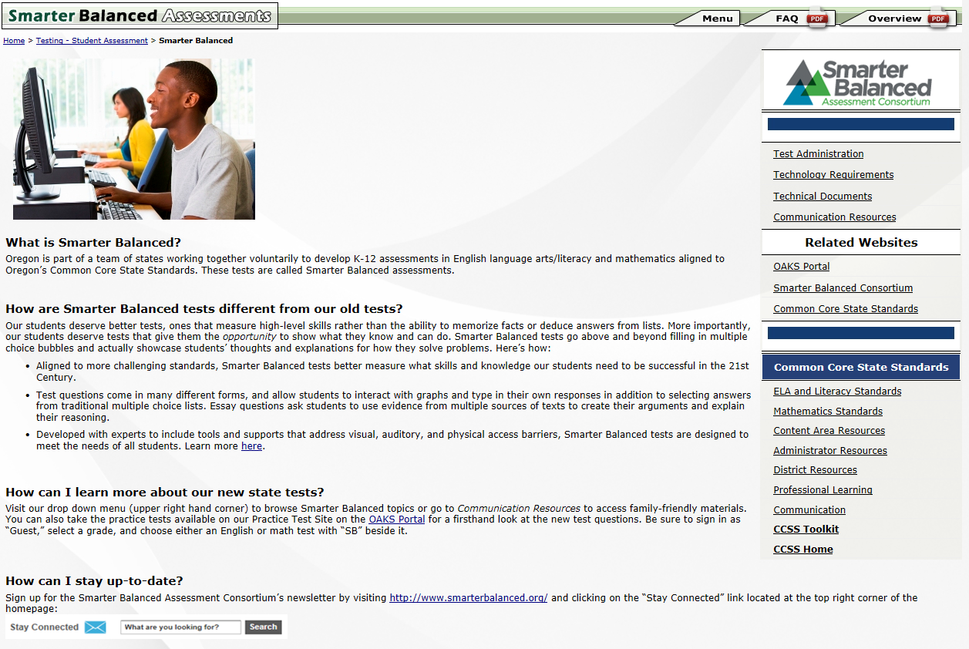
ODE Webpage Reorganization
  New look & feel
  User friendly
  Direct access to resources & related websites
  “Go” link: http://www.ode.state.or.us/go/smarterbalanced

Slide 7
Test Administration Support
Promising Practices
  Classroom Activity
    Includes several promising practices that teachers and test administrators might consider when preparing to administer the classroom activity
  Sample Test Windows
    Sample school‐level test schedules that help guide districts through the process of establishing school‐level test windows
  How To Set Up A Test Session
    Step-by-step video tutorial on setting up a Smarter Balanced test session (including accessibility supports).
  http://www.ode.state.or.us/search/page/?=2444
Notes:
Promising Practices:
Recently developed supports in response to feedback from the field test and requests from the field
All Promising Practices are available at: http://www.ode.state.or.us/search/page/?=2444

Slide 8
Communication Support
Communication Resources
  Handouts—Factsheets, FAQs
  PowerPoint Presentation Materials
  Communications Toolkit for Educators
  Videos
  Infographics
Notes:
Our Smarter Balanced Communication Resources Webpage provides an essential clearinghouse for family-friendly materials—many in both English and Spanish
Available at http://www.ode.state.or.us/search/page/?id=4302
ODE’s FF Roadshow is in collaboration with local school districts and the Oregon PTA and is part of a larger departmental effort to increase awareness of Oregon’s state tests, provide accurate information to our communities, and dispel myths surrounding state standards and associated testing.

Slide 9
OAKS to Smarter Balanced Transition

Slide 10
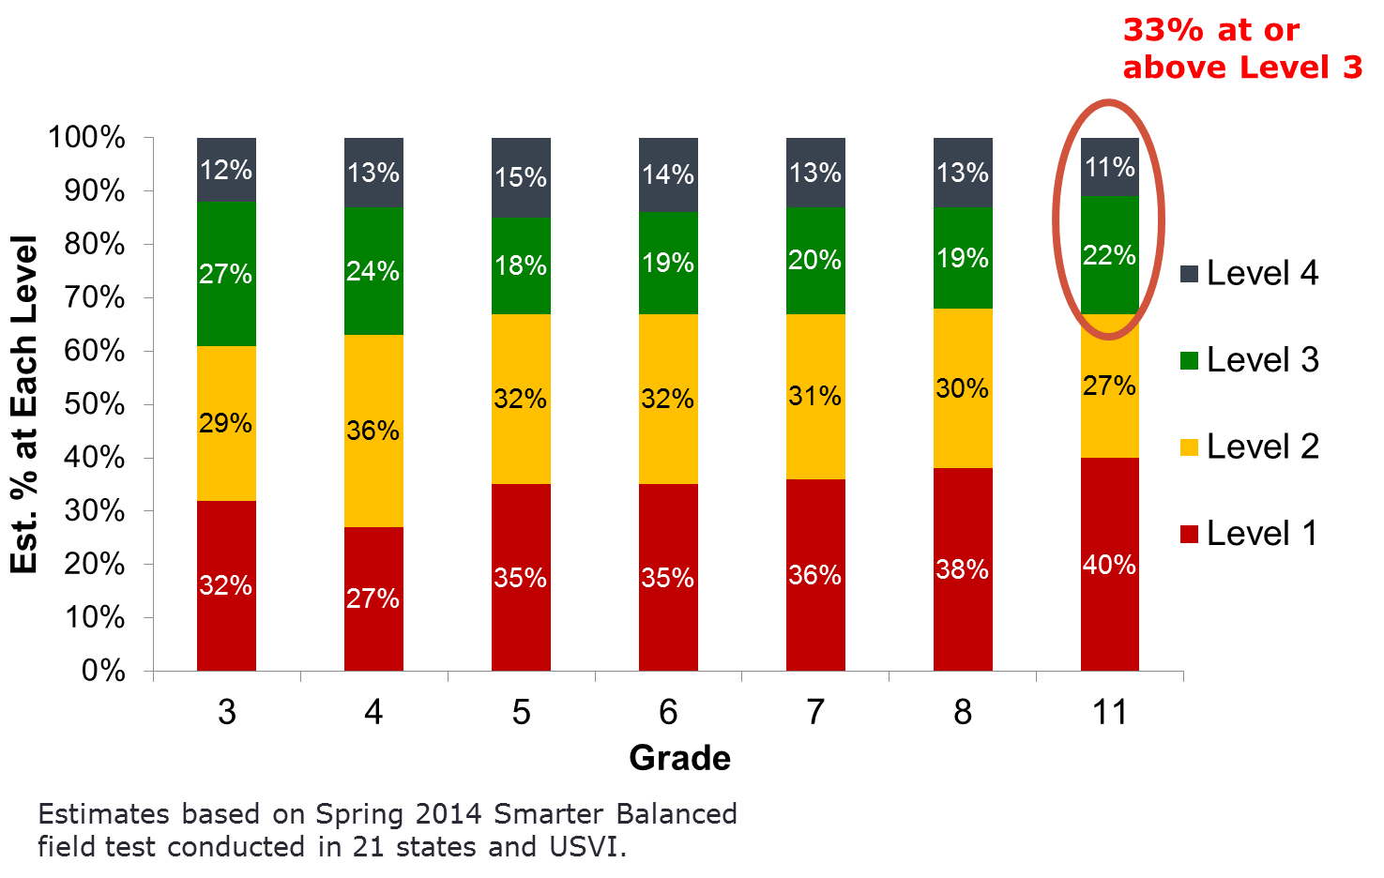
Percentage of Students by Achievement Level: Mathematics
Notes:
Consortium-wide:
4.2+ million students across 16,549 schools
19,000 items and performance tasks
Oregon
24,000+ students across 195 schools
Lessons Learned
Surveys and focus groups with 2,549 students and 93 educators
Prioritize TA and student familiarity with test interface and question types early;
Strengthen instructional alignment to Oregon’s new content standards;
Increase opportunities for students to practice typing, word processing, multi-step problem-solving, and writing.

Slide 11
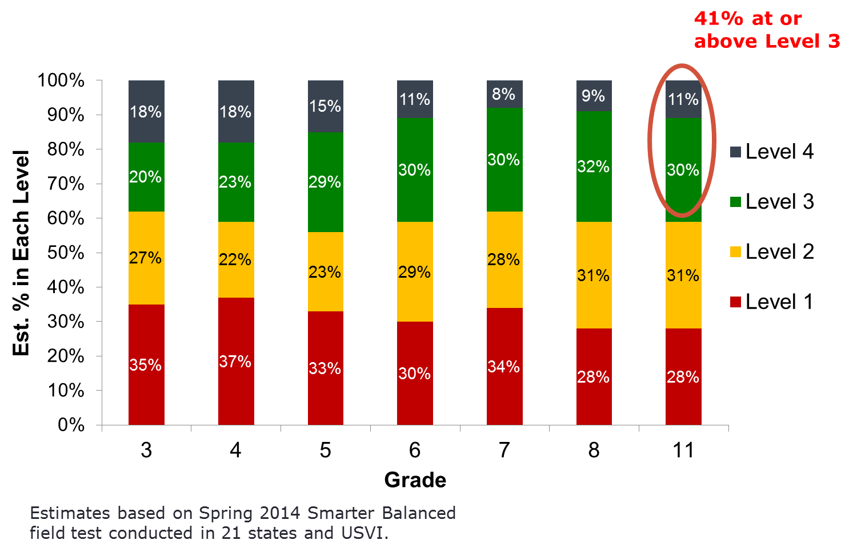
Percentage of Students by Achievement Level: ELA/Literacy

Slide 12
Comparing Smarter Balanced with OAKS (High School)
At grade 11, the Smarter Balanced impact data suggest that approximately 33% of consortium students will meet or exceed the Level 3 standard in mathematics, and 41% in ELA/Literacy.
The Level 3 standard is intended to represent the academic readiness threshold for success in non-remedial college courses.
By applying the same percentages to the 11th grade OAKS score distributions in mathematics and reading, the OAKS scores in the following table are equivalent to the respective Smarter Balanced performance levels. (Note: this relies on evidence presented earlier that Oregon is close to the consortium average.)

Slide 13
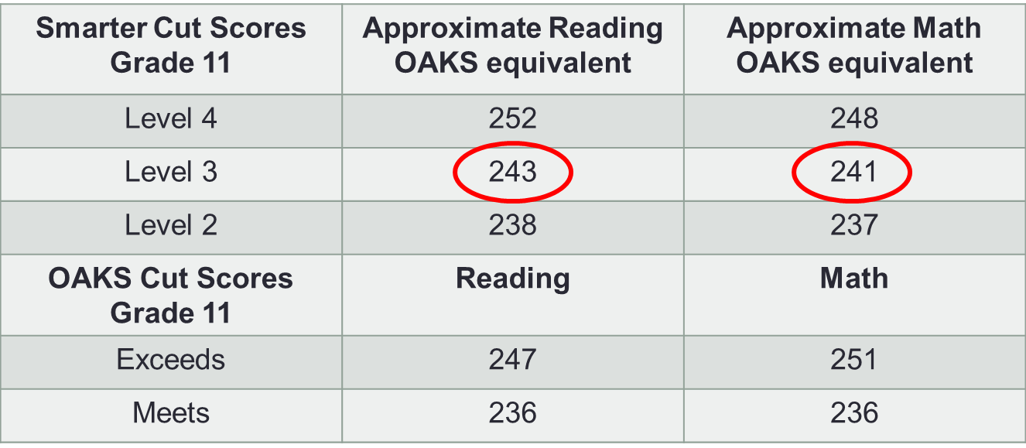
Comparing Smarter Balanced with OAKS (High School)

Slide 14
Oregon Academic Preparedness—OAKS, SAT, ACT, OUS
For the past several years, the Oregon University System has provided data on the performance of students in the first year of college.
Part of this analysis predicts the relationship between freshman GPA and students’ performance on OAKS in high school.
The college success criterion defined by the College Board is a 0.65 probability of receiving a freshman GPA of B- or higher.
OAKS scale scores of 243 in Reading and 242 in Mathematics best predict College Board readiness standards as shown by the OUS data for the entering class of 2012-13.

Slide 15
Oregon Academic Preparedness—OAKS, SAT, ACT, OUS
The relationship between OAKS scores and freshman year college GPA provides independent evidence that the Level 3 standards established by Smarter Balanced are consistent with college readiness.
The college readiness benchmark defined by ACT is a score of 22 on the Mathematics and Reading tests.
ACT scores of 22 in Mathematics and Reading align to an OAKS Reading score of 244, and an OAKS Mathematics score of 242.

Slide 16
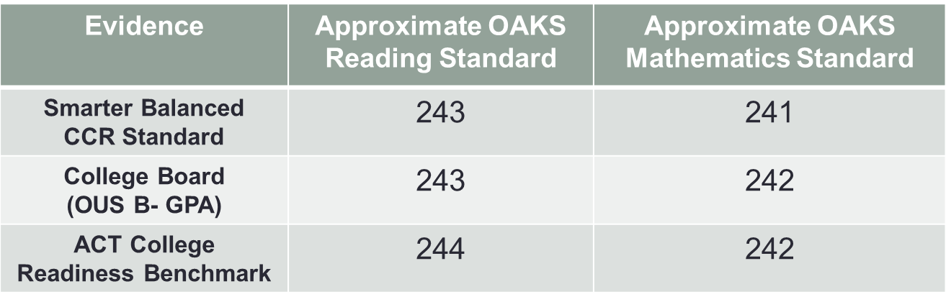
Independent Sources of College Readiness Evidence
Three independent sources of evidence help confirm a consistent estimated OAKS equivalent “cut score” reflecting Smarter Balanced Level 3 achievement.

Slide 17
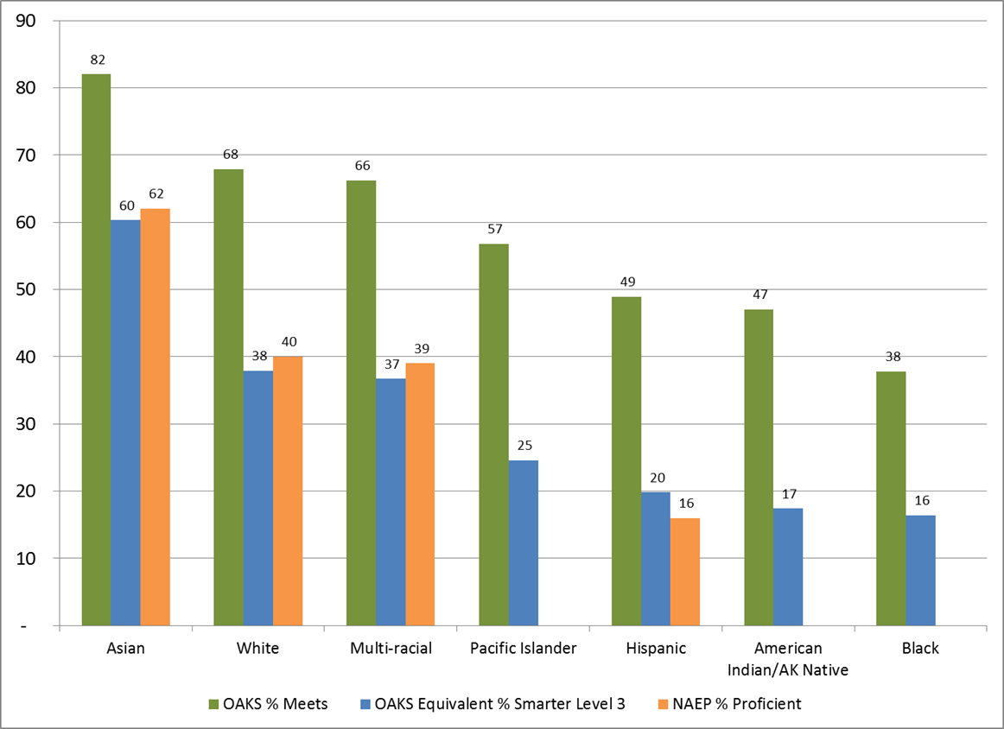
Math Grade 8 Impact Data

Slide 18
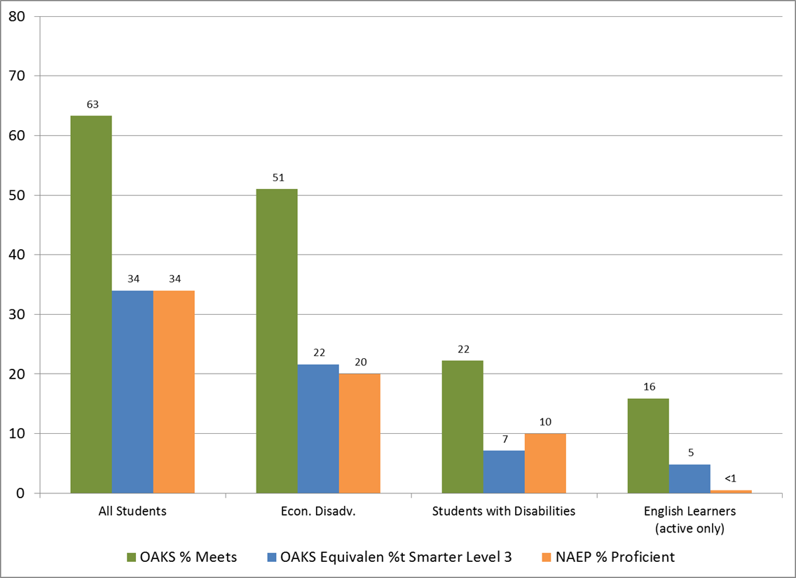
Math Grade 8 Impact Data

Slide 19
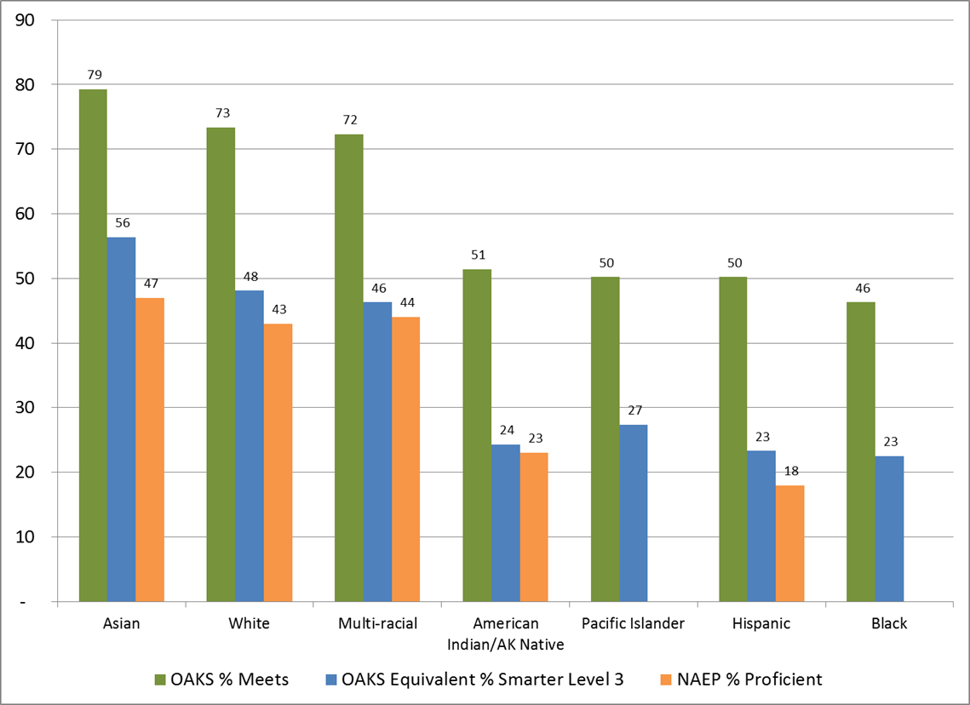
Reading Grade 8 Impact Data

Slide 20
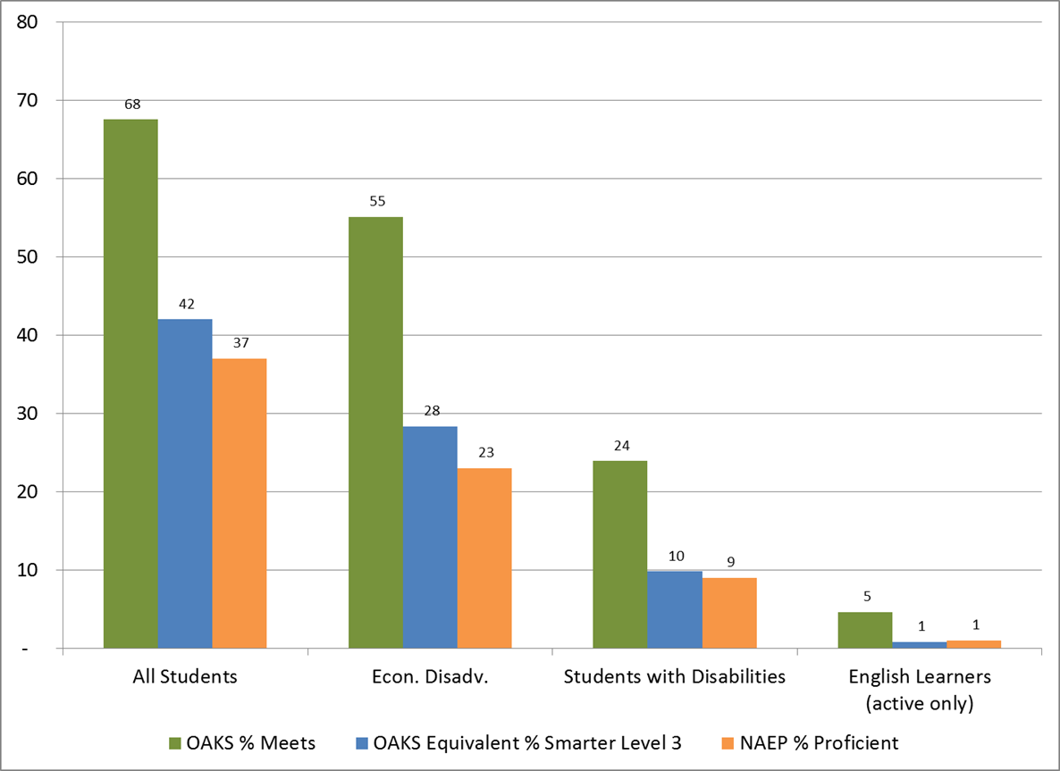
Reading Grade 8 Impact Data

Slide 21
Opportunity to Learn
There are a number of reasons we can expect to see Oregon students’ achievement on the Smarter Balanced assessments improve over time.
  Exposure to standards
  Improved instructional practice
  Alignment of instructional materials
  Student motivation and familiarity with the tests
  Improvements to test delivery system
  Adaptive test engine

Slide 22
Student Accountability – Essential Skills
Three primary methods
  Direct linking using SB field test data
  OAKS item embedding in Smarter Balanced
  Evaluating percentages of students meeting standards
Goal is to find reasonable confirmatory evidence.
Statistical analysis approach, utilize professional judgment if necessary.

Slide 23
Contact Information
Derek Brown
Director of Assessment
derek.brown@state.or.us
503-947-5841

